Slide 1

MONTREAL RACE PREVIEW
Para Series Analysis · June 24 – 27, 2026
USA Triathlon High Performance

Slide 2
Race Week Schedule
Montreal
June 24 – 27, 2026 • Parc Jean-Drapeau, Notre-Dame Island, Montréal (EDT, UTC-4)
Thu • June 25
Fri • June 26
Sat • June 27
Open Training
Familiarization & Briefing
PARA RACE DAY
11:00 – 15:00 | Swim training — Aquatic Complex (50 m pool, 4 lanes)
14:00 – 17:00 | Gym training — Athletes' Quarter gym
(Wed Jun 24) | Pool training 14:00–18:00 + gym 14:00–17:00
07:45 | Departures from Host Hotel
08:45 – 09:15 | PTS/PTVI Bike Fam • PTWC Run Fam — Transition
09:30 – 10:00 | PTS/PTVI Run Fam • PTWC Bike Fam — Transition
10:15 – 11:00 | Swim Familiarisation (ALL) — Swim Start
10:15 – 10:45 | Coaches Onsite Meeting — Transition Area
10:30 – 12:00 | Equipment verification (ALL)
12:00 – 12:45 | ★ WTPS Pre-race briefing (ALL) — Athletes' Quarter
12:45 – 13:30 | Race Package Distribution
13:45 | Departures from venue
05:00 / 05:30 | Hotel departures — PTWC 05:00 • PTS/PTVI 05:30
05:30 / 06:15 | Athletes' Lounge opens — PTWC 05:30 • PTS/PTVI 06:15
06:15 – 06:45 | PTWC swim warm-up (on course) + transition check-in
06:53 | PTWC Athletes' Introduction
07:00 / 07:03 | ★ PTWC1 Men 07:00 • PTWC2 Men 07:03
07:04 / 07:08 | ★ PTWC1 Women 07:04 • PTWC2 Women 07:08
07:45 | ★ PTS5 Men start
07:50 / 07:53 | ★ PTVI1 Men 07:50 • PTVI2/3 Men 07:53
07:54 / 07:57 | ★ PTVI1 Women 07:54 • PTVI2/3 Women 07:57
08:10 / 08:15 | ★ PTS5 Women 08:10 • PTS2/3/4 Women 08:15
08:25 / 08:30 | ★ PTS4 Men 08:25 • PTS2/3 Men 08:30
10:15 / 12:00 | Venue departures — 1st bus 10:15 • 2nd 12:00
10:30 – 11:30 | WTPS Medal Ceremony — Podium
Times Montréal (EDT, UTC-4)

Slide 3
Key Course Differentiators
Montreal
MONTREAL
COURSE AT A GLANCE
World Triathlon Para Series Montréal returns to Parc Jean-Drapeau for the 2026 edition. The race uses the Olympic Basin for a 750 m swim, then heads to the Circuit Gilles-Villeneuve, the F1 track, a 21.5 km bike closed circuit course. The run mixes the CGV and the path alongside the rowing basin for 2 laps of 2.5km. Late June in Montréal can run hot and humid; with 23 °C water, expect a non-wetsuit race and a power-driven bike.
Swim:
750 m – 1 lap
Bike:
21.5 km – 5 laps × 4.1 km + connections
Run:
5 km – 2 laps × 1.8 km + connections
Format:
Sprint Para Triathlon
COURSE FEATURES
Bike Laps:
5
Run Laps:
2
• Olympic Basin swim. Sheltered, ~23 °C fresh water, in-water pontoon start. Likely Non-wetsuit.
QUICK LINKS
Current Race Info:
• Bike on Circuit Gilles-Villeneuve (F1 track): pancake-flat 4.1 km clockwise loop × 5 + connectors = 21.5 km.
Race Info | 2026 World Triathlon Para Series Montréal
2025 Resutls:
Results | 2025 World Triathlon Para Series Montreal
• Run on CGV + Olympic Basin path: flat 1.8 km loop × 2 with a decent stretch before and after the main loop to total 5km.

Slide 4
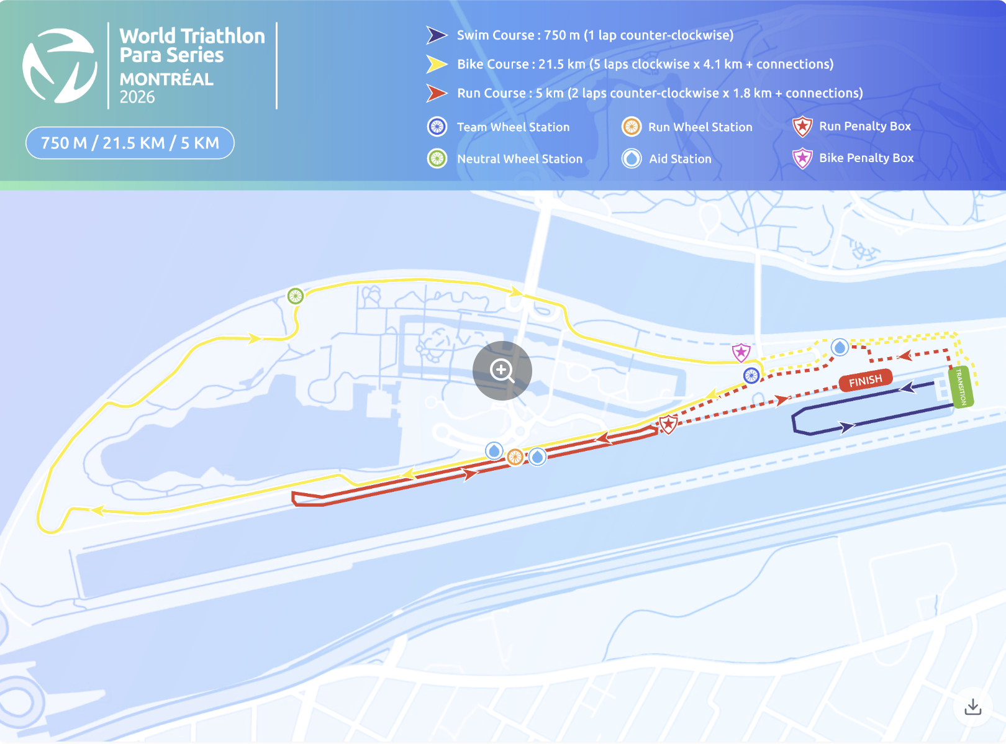
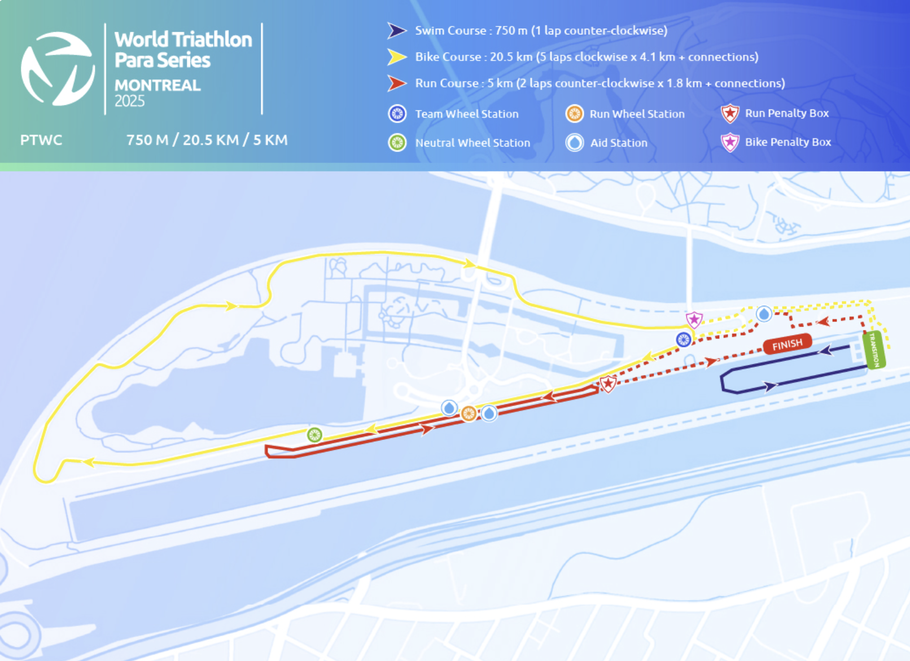
Course Profile & Map
Montreal
[PLACEHOLDER: Insert upcoming course map or race photo here] Right-click → Replace Image, or paste screenshot of the World Triathlon course map PDF.
[PLACEHOLDER: Insert previous year course map or race photo here] Right-click → Replace Image, or paste screenshot of the World Triathlon course map PDF.
2026 Course
2025 Course
Source: Race Info | 2026 World Triathlon Para Series Montreal
Source: https://www.triathlon.org/events/event/2024_americas_triathlon_cup_montreal
Discipline | Distance | Laps | Terrain / Notes
Swim | 750 m | 1 | Olympic Basin swim. Sheltered, ~23 °C fresh water, in-water pontoon start. Likely Non-wetsuit.
Bike | 21.5 km | 5 | Bike on Circuit Gilles-Villeneuve (F1 track): pancake-flat 4.1 km clockwise loop × 5 + connectors = 21.5 km. Note that the course is slightly long than in 2025 measuring 1km longer.
Run | 5.0 km | 2 | Run on CGV + Olympic Basin path: flat 1.8 km loop × 2 with a decent stretch before and after the main loop to total 5km.

Slide 5
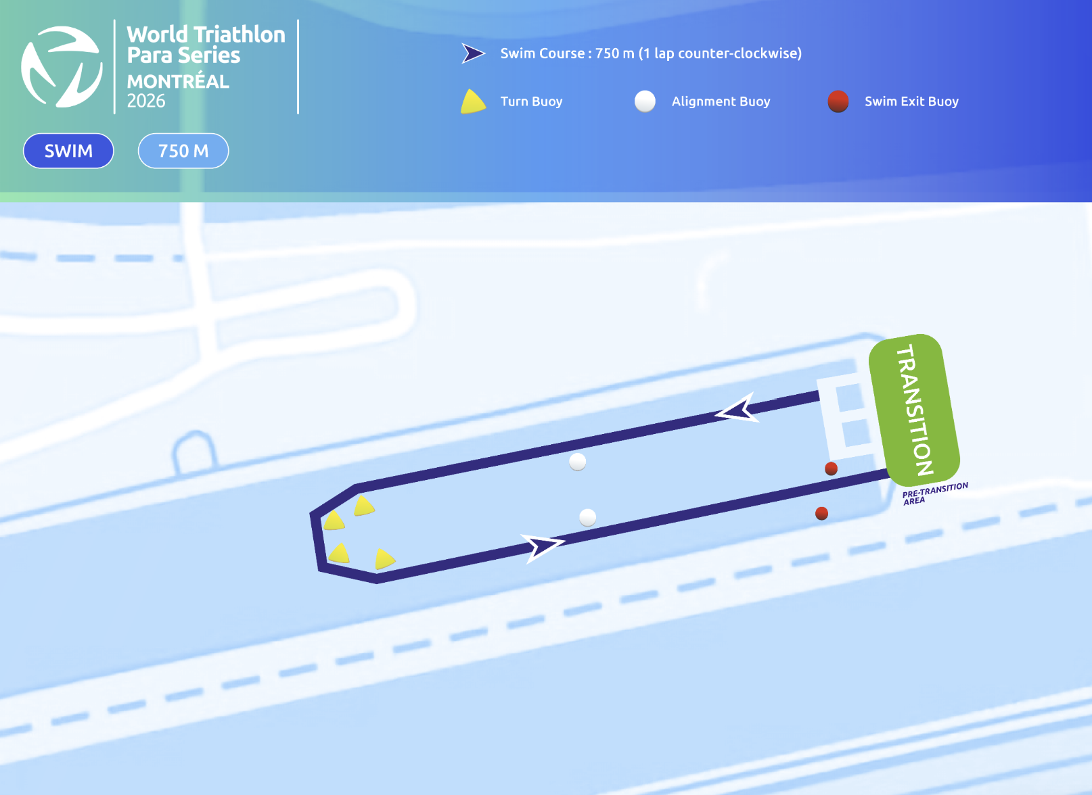
Swim Course Profile
Montreal
750 m • single lap
Sheltered rowing basin ,fresh water, calm conditions
Distance
Layout
Start
750 m
Olympic Basin
In water pontoon
[Drop swim course map here] Save the organiser map as: ppt files/support/montreal_swim_course.png It will be embedded automatically on the next run.
Water Temp
Wetsuit
Lap Count
22.0–24.0 °C
Likely non-wetsuit
1
Tactical Notes
• Sheltered Olympic Basin water. Typically minimal chop/current.
• PTWC swim warm-up on course 06:15–06:45; PTS/PTVI use warm-up lane 07:00–08:15
Source: World Triathlon Para Series Montréal Elite Athlete Guide — 27 Jun 2026
• Lounge opens 05:30 (PTWC) / 06:15 (PTS/PTVI); athletes' intro 10 min before category start
• Warm water + warm air at 7 AM start. No cold-water acclimation concerns

Slide 6
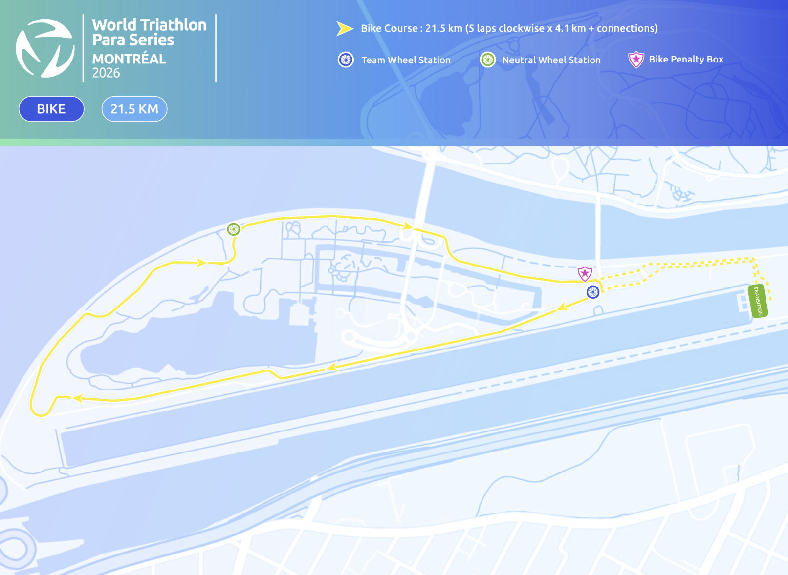
Bike Course Profile
Montreal
21.5 km • 5 × 4.1 km loops
Closed F1 circuit, Circuit Gilles-Villeneuve, Parc Jean-Drapeau
[Drop course map here] Save the organiser course map as: ppt files/support/montreal_bike_course.png It will be embedded automatically on the next run.
Elevation / Lap
Total Climb
Avg Grade
Flat (no data)
—
—
Max Climb Grade
Wind
Loops
—
Variable
5 × 4.1 km
Tactical Implications
• Bike held on the Circuit Gilles-Villeneuve (CGV) F1 track. Clockwise 4.1 km loop × 5 + connections = 21.5 km
Source: World Triathlon Para Series Montréal Elite Athlete Guide — 27 Jun 2026
• Pancake-flat, smooth tarmac throughout. No significant climbs favoring pure power profiles
• Team wheel station at the CGV entrance; Neutral wheel station mid-lap
• Bike penalty box sits at the lap/transition split — athletes pass it 5 times across the race
• Open island setting on Notre-Dame Island. Some potential for winds off the St. Lawrence can swing crosswinds on the straights
Flat course — published profile shows no significant climbs. No elevation chart synthesized

Slide 7
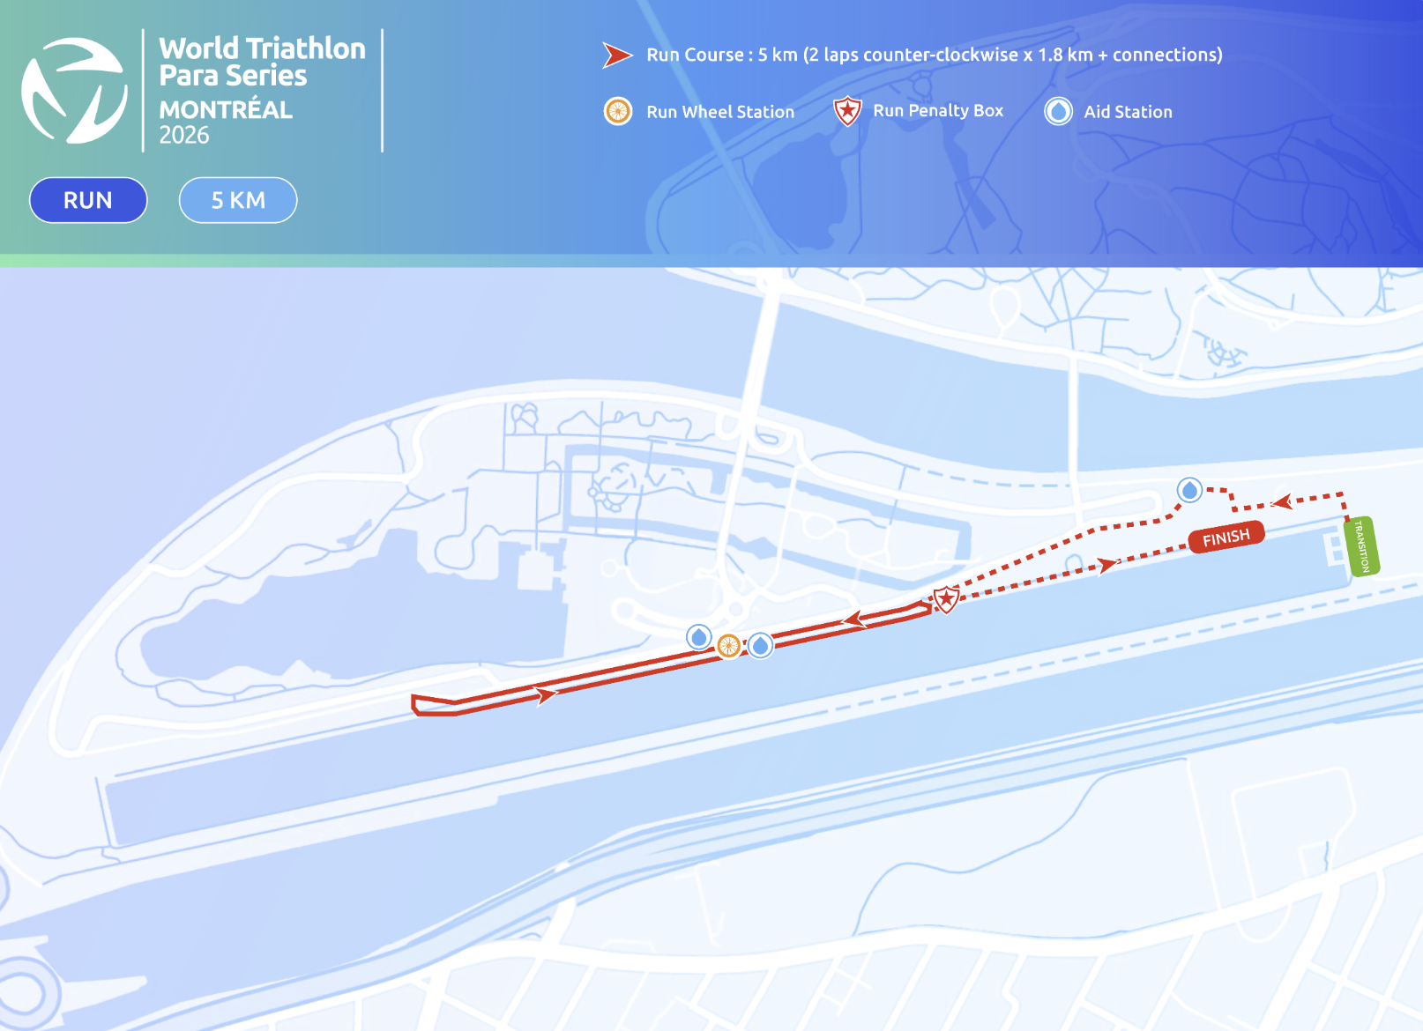
Run Course Profile
Montreal
5.0 km • 2 × 2.5 km
Asphalt, Circuit Gilles-Villeneuve + Olympic Basin path
Distance
Lap Structure
Total Climb
5.0 km
2 × 2.5 km
Not published
[Drop run course map here] Save the organiser map as: ppt files/support/montreal_run_course.png It will be embedded automatically on the next run.
Avg Grade
Max ▲ / ▼
Heat Risk
—
Not published
MODERATE
Tactical Notes
• Flat 1.8km loop × 2 + opening and closing connecting stretches. Exit transition north of basin, enter CGV at the hairpin, head west to pit lane. Two left turns at the pit lane drop onto the north-side path along the Olympic Basin
• Aid stations / water at 370 m, 1.1 km, 2.3 km, 3.0 km, 4.1 km
Source: World Triathlon Para Series Montréal Elite Athlete Guide — 27 Jun 2026
• Run penalty box at ~2.6 km (loop turnaround)
• PTVI Free Leading zones: T2 exit→AS1, AS2 on CGV, paddocks turnaround, AS2 on Chemin Nord, Run Penalty Box turn
• Run team wheel station (for racing wheelchairs) co-located with Aid Station 2
Not in race brief: Elevation profile (course described as flat — no published grade data)

Slide 8
Travel & Arrival Load
Denver, CO → Montréal race week
Core travel read
Denver → Montréal is a same-day journey with multiple nonstop options (Air Canada / United / WestJet) or easy one-stop itineraries through ORD, YYZ, or EWR. Only +2 h time-zone shift (MDT → EDT), so jet-lag impact is minimal. LOC operates a scheduled airport shuttle YUL ↔ Alt Hotel Montréal between June 23–28 (60 USD mandatory per-person fee). World Triathlon also provides official Wed/Thu pool + gym training windows ahead of Friday's familiarization.
Primary route
Flight time
Time zones
Airport Transfer
Transfer Distance
DEN → YUL
~3h 45m
+2h
YUL → Alt Hotel
19 km / ~20 min
Nonstop available
Nonstop estimate
Montréal ahead of Denver
LOC shuttle (60 USD)
By car/shuttle
Host Hotel / Official Accommodation Read
Food / Grocery Options Near Hotel + Venue
• Official hotel: Alt Hotel Montréal (Germain Group), 120 Peel Street, H3C 0L8.
• Best stock-up: Provigo / IGA / Métro grocery stores within walking distance of Alt Hotel (Peel St / Saint-Antoine corridor).
• Block code "2606OBTRIA" — book via the WTPS reservations link, email reservations.altmontreal@germainhotels.com, or call 514.375.0220.
• Quick basics: Tim Hortons / Couche-Tard / Starbucks Jean Contu
• Distance to venue (Parc Jean-Drapeau): 6.3 km — 15 min by car or bike; LOC provides free venue transport on familiarization + race day.
• Athlete-friendly restaurants: Marcus, Burgundy Lion, and the Cours Mont-Royal food court score strong reviews and are within 15 min walk
• Venue note: Parc Jean-Drapeau is on Notre-Dame Island. Helpful to bring race-day food/fluid from the hotel; on-island vendor options may be limited.
• Hotel is downtown (Griffintown adjacent). Easy walk to Old Montréal, restaurants, and metro access.
• Heat consideration: Late June can hit 30 °C+. Electrolytes / ice packs should be utilized

Slide 9
Environmental Risk Profile
Montreal
RACE-DAY WEATHER (08:00–11:00 local)
AIR QUALITY (Open-Meteo archive)
Year | Date | Air Temp | Humidity | Wind km/h | Precip mm
2018 | Aug 25 | 22.3°* | 66% | 6 | 0.0
2018 | Aug 25 | 22.3°* | 66% | 6 | 0.0
2019 | Jun 28 | 23.1°* | 66% | 10 | 0.0
2019 | Jun 29 | 22.6°* | 75% | 11 | 0.1
2021 | Aug 13 | 26.5°* | 76% | 13 | 0.0
2022 | Jun 24 | 20.1°* | 79% | 5 | 0.0
2023 | Jun 24 | 24 | 80% | 4 | 0.1
2023 | Jul 08 | 27.8 | 79% | 5 | 0.0
2024 | Jun 29 | 22.0°* | 70% | 10 | 0.0
2025 | Jul 19 | 25.8°* | 68% | 8 | 0.0
Year | PM2.5 | EU AQI | UV Index | Risk
2018 | — | — | — | —
2018 | — | — | — | —
2019 | — | — | — | —
2019 | — | — | — | —
2021 | — | — | — | —
2022 | — | — | — | —
2023 | 13.2 | 26 | 2.6 | Fair
2023 | 9.8 | 33 | 3.0 | Fair
HEALTH & WATER QUALITY RISK FACTORS
• Water Quality: Official Montréal Triathlon page says the Parc Jean-Drapeau Olympic Basin meets World Triathlon water-quality standards.
• Athlete Health Incidents: No public Montréal-specific GI illness cluster found. Bigger practical risk is humid mornings.
• Water Temperature: Olympic Basin freshwater is typically warm for late June (~22–24°C). Expect likely non-wetsuit with no cold-water acclimation concern.
• Heat / Humidity Risk: Historical race windows are usually mild-to-warm but humid. Current Jun 27 forecast is cooler (~21°C high / 11°C low), so heat risk looks moderate-low unless humidity or storms build.
Weather and AQ data: Open-Meteo historical archive (archive-api.open-meteo.com). EU AQI: Good ≤20, Fair ≤40, Moderate ≤60, Poor ≤80, Very Poor >80.

Slide 10
PARA MEN

Slide 11
Para Series Results — Men
Montreal
Year | Date | PTWC | PTS2 | PTS3 | PTS4 | PTS5 | PTVI
2019 | Jun 28 | Plat 56:16 | Ribstein 1:07:26 | Molina 1:09:37 | Hanquinquant 1:00:48 | Daniel 57:30 | Ellis 1:00:24
2022 | Jul 08 | Plat 56:25 | Morales 1:11:40 | Godfrey 1:12:40 | Peacock 1:05:34 | Daniel 59:10 | Coon 1:01:12
2023 | Jul 08 | Sanborn 1:01:00 | Morsink 1:08:22 | Burgt 1:11:26 | Hanquinquant 57:53 | Daniel 57:24 | Laparra 58:52
2024 | Jun 29 | Romele 1:01:01 | Lahna 1:07:09 | Urand 1:09:43 | Hanquinquant 58:29 | Hammer 56:50 | Rigaudeau 57:29
2025 | Jul 19 | Noel 1:02:50 | Paepe 1:06:52 | Gelhaar 1:06:59 | Baele 59:17 | Daniel 56:35 | Kelly 57:51
World Para Series Men winners by sport class. Surname + winning total time. Years with no completed racing are omitted.

Slide 12
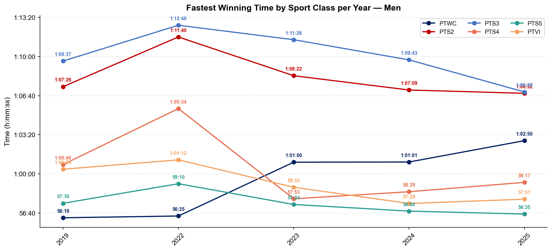
Winning Time Trends — Para Men
Montreal

Slide 13
PARA WOMEN

Slide 14
Para Series Results — Women
Montreal
Year | Date | PTWC | PTS2 | PTS3 | PTS4 | PTS5 | PTVI
2019 | Jun 28 | Tapp 1:07:25 | Seely 1:20:12 | Plotnikova 1:24:12 | Moore 1:11:30 | Cashmore 1:06:13 | Rodriguez 1:08:33
2022 | Jul 08 | Parker 1:05:08 | Danz 1:20:03 | — | Elmlinger 1:13:24 | Norman 1:05:45 | Rodriguez 1:07:24
2023 | Jul 08 | Parker 1:03:32 | Danz 1:14:40 | Vargas 1:28:01 | Elmlinger 1:13:26 | Norman 1:03:06 | Rodriguez 1:04:00
2024 | Jun 29 | Gretsch 1:05:34 | Seely 1:14:20 | Vargas 1:24:44 | Elmlinger 1:10:45 | Frenette 1:07:59 | Rodriguez 1:04:26
2025 | Jul 19 | Parker 1:03:08 | Francis 1:16:43 | Vargas 1:18:47 | Seneclauze 1:14:01 | Norman 1:02:03 | Freitas 1:05:47
World Para Series Women winners by sport class. Surname + winning total time. Years with no completed racing are omitted.

Slide 15
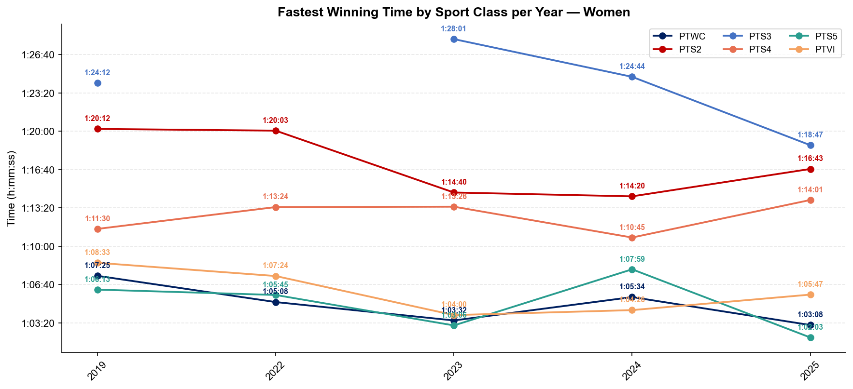
Winning Time Trends — Para Women
Montreal

